Slide 1

From Unstructured Text to Structured Data – Part I
Dr. Michael Fire
Notes:
https://pixabay.com/illustrations/narrative-history-dream-tell-794978/

Slide 2
Lecture Motivations:
- Learn to analyze massive amounts of text
- Transfer unstructured texts to structured data

Slide 3

Bag-of-Words
A simple text representation model. Using the model,
we count the number of times each word appears in
a document.

Slide 4
Bag-of-Words
Pros:
Easy to understand and simple to use
Usually provides decent results
Cons:
Creates many features (tens-of-thousands of features)
Doesn’t take into account other documents
Doesn’t provide state-of-the-art results
It’s possible to miss important characters by removing punctuation

Slide 5

N-Grams
“N-gram is a contiguous sequence of n items from a given sample of text or speech. The items can be phonemes, syllables, letters, words or base pairs according to the application” (from Wikipedia)

Slide 6
N-Grams
Pros:
Easy to understand and simple to use
Can be used both for “characters” or “words”
Can utilize useful punctuation and other special characters
Usually provides decent results
Cons:
Creates many features (hundreds-of-thousands of features)
Doesn’t take into account other documents
Doesn’t provide state-of-the-art results

Slide 7

Term Frequency–Inverse Document Frequency (TF-IDF)
TF-IDF is used to reflect how important a word is to a document in a collection
A word’s TF–IDF value increases proportionally to the number of times it appears in a document and is offset by the number of documents in the corpus that contains it

Slide 8
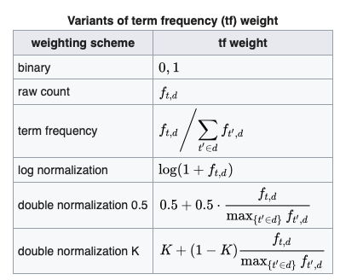
Term Frequency
A term frequency, tf(t,d), can be the number of time a word appears in a document (there can also be other measures)
see Wikipedia

Slide 9
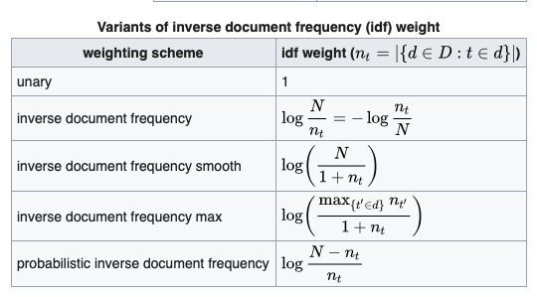
Inverse Document Frequency
The inverse document frequency, idf(t,D), measures if words are common or rare across all documents.
Usually it is calculated as the logarithm of the number of documents in the collection divided by the number of documents in which the word or term appears.
tfidf(t,d,D) = tf(t,d)*idf(t,D)
see Wikipedia

Slide 10
TF-IDF
Pros:
Easy to understand and simple to use
Usually provides decent results
Takes into account other documents
Cons:
Creates many features (tens-of-thousands of features)
Doesn’t provide state-of-the-art results

Slide 11

Topic Model
A topic model is a statistical model for discovering the abstract "topics" that occur in a collection of documents. Topic model algorithms are used to discover hidden subjects in a large collection of unstructured texts

Slide 12

Latent Dirichlet Allocation
“A generative statistical model that allows sets of observations to be explained by unobserved groups that explain why some parts of the data are similar.”
A document is a collection of topics
A topic is collection of keywords
Notes:
LDA assumes that each document in a corpus is a mixture of several topics, and that each topic is a probability distribution over a fixed vocabulary of words.
The goal of LDA is to learn the underlying topics that generate the observed documents in the corpus, as well as the distribution of topics within each document.
LDA uses Bayesian inference to estimate the parameters of the model, including the topic-word distributions and the document-topic distributions.
LDA is typically implemented using an iterative algorithm that alternates between estimating the topic-word and document-topic distributions and assigning words to topics.
LDA has a wide range of applications, including document classification, information retrieval, and topic modeling for social media analysis, market research, and other areas.
LDA assumes that each document in a corpus is a mixture of several topics, and that each topic is a probability distribution over a fixed vocabulary of words.
The goal of LDA is to learn the underlying topics that generate the observed documents in the corpus, as well as the distribution of topics within each document.
LDA uses Bayesian inference to estimate the parameters of the model, including the topic-word distributions and the document-topic distributions.
LDA is typically implemented using an iterative algorithm that alternates between estimating the topic-word and document-topic distributions and assigning words to topics.
LDA has a wide range of applications, including document classification, information retrieval, and topic modeling for social media analysis, market research, and other areas.

Slide 13
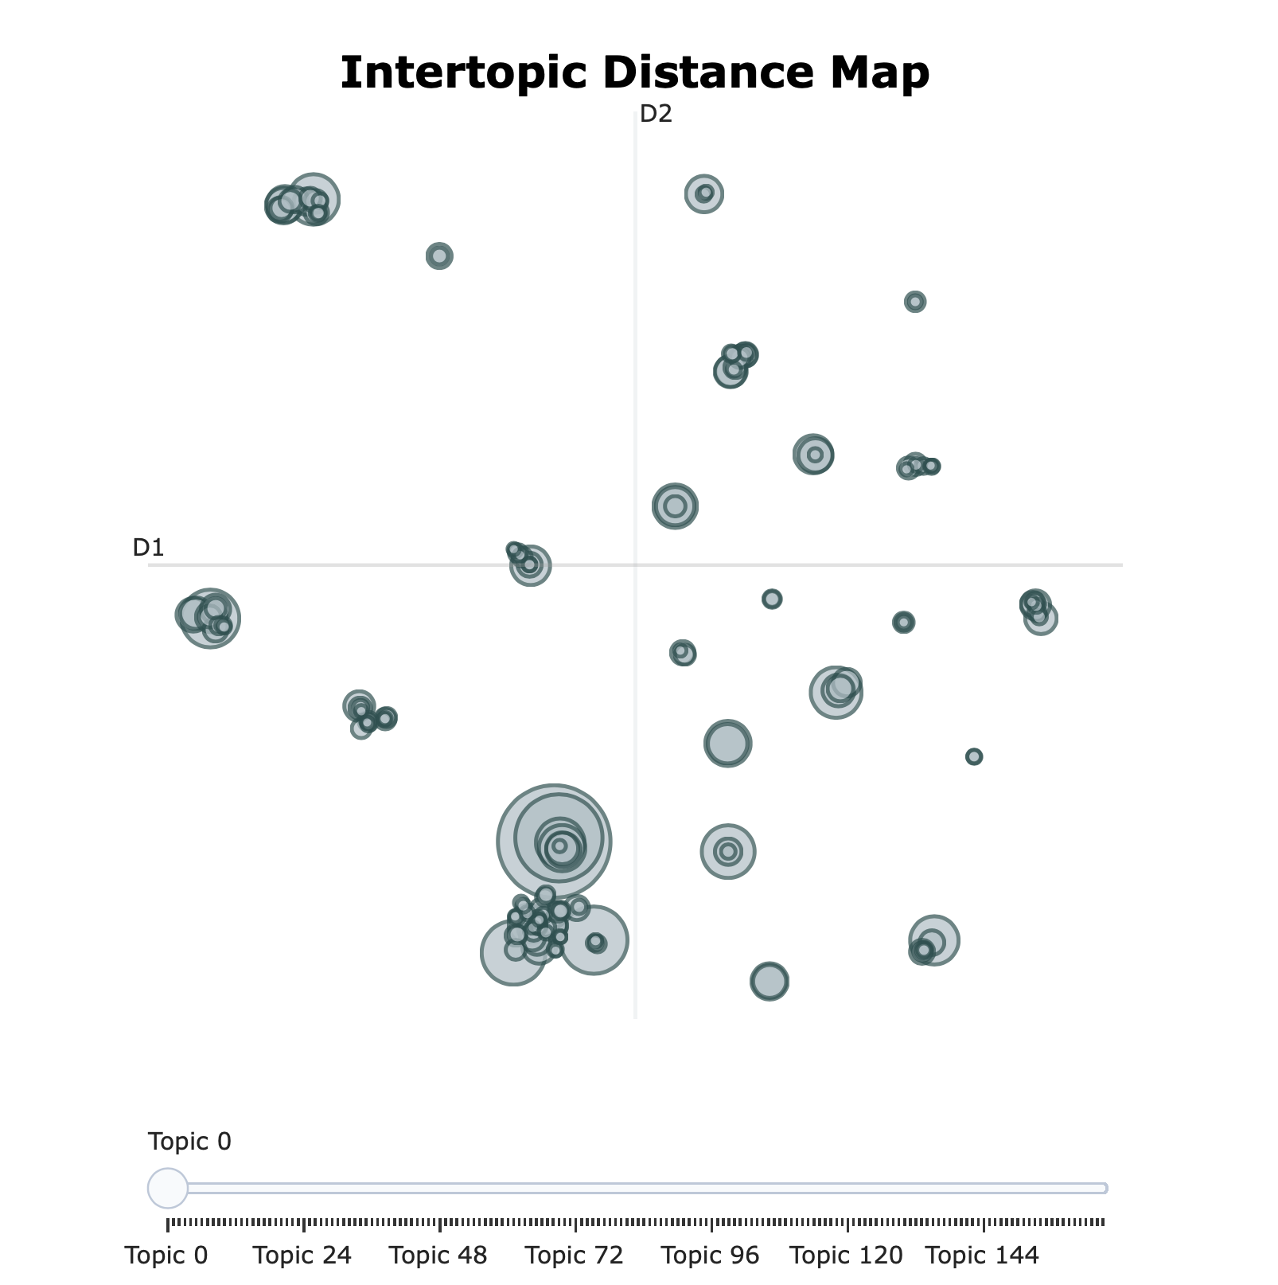

BERTopic
A state-of-the-art approach for topic modeling, which combines the power of the transformer-based language model BERT with unsupervised clustering techniques.
Notes:
BertTopic uses BERT to extract contextualized word embeddings from the input text, which capture the meaning of words in context.
These embeddings are then clustered using an unsupervised clustering algorithm, such as K-means or hierarchical clustering, to group similar words into topics.
BertTopic allows for fine-grained topic modeling, as it can identify subtopics within broader topics and assign multiple topics to a single document or sentence.
BertTopic is highly effective for modeling topics in large, complex datasets, such as social media posts, news articles, or scientific papers.
BertTopic has a wide range of applications, including content recommendation, sentiment analysis, and market research.

Slide 14
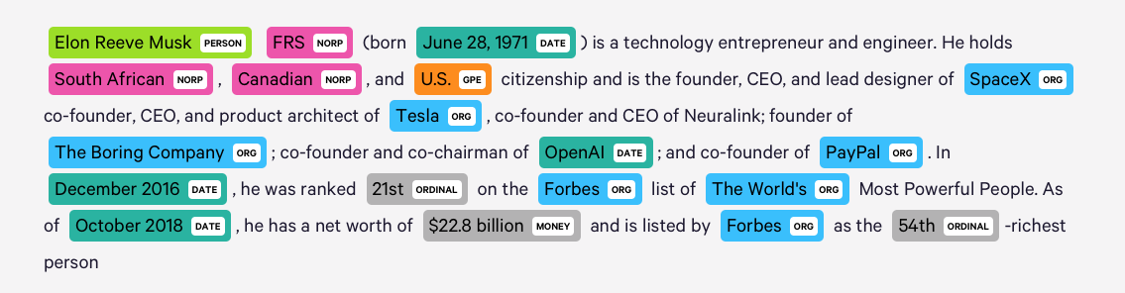
Named-Entity Recognition
Entity Extraction
Entity Extraction is a task that seeks to locate and classify named entity mentions in unstructured text into predefined categories.

Slide 15
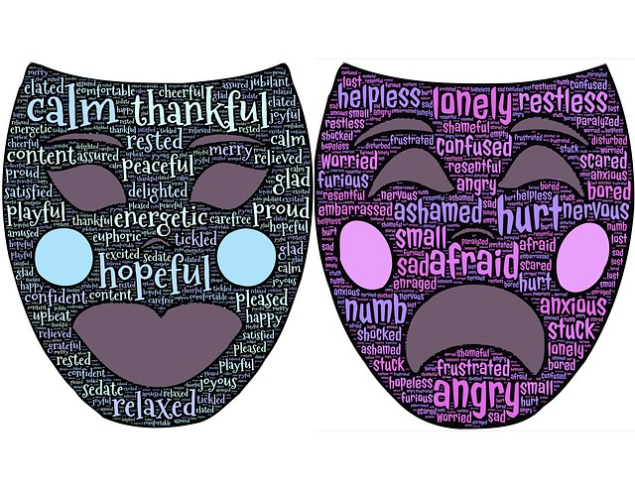
Sentiment Analysis
Sentiment analysis (also referred to as opinion mining) is using NLP to identify, extract, quantify, and study affective states and subjective information.

Slide 16

Hugging Face
A startup company that specializes in developing natural language processing (NLP) models and tools for machine learning applications.
They provide a variety of models and tools, including pre-trained models for tasks such as text classification, machine translation, and question-answering and more
Their flagship product is the Transformers library, which is built on top of PyTorch and provides a range of transformer-based models, including BERT, GPT-2, and RoBERTa.

Slide 17

Word Embeddings
“Word embeddings is the collective name for a set of language modeling and feature learning techniques in natural language processing (NLP) where words or phrases from the vocabulary are mapped to vectors of real numbers” (Wikipedia)

Slide 18
Word Embeddings
Pros:
Easy to use
In many tasks provides state-of-the-art results
Cons:
Small features space
Can be domain sensitive (can be missing words/spelling sensitive)

Slide 19
Recommended Read:
Topic Modeling with Gensim by Selva Prabhakaran
A Practitioner's Guide to Natural Language Processing (Part I) — Processing & Understanding Text by Dipanjan (DJ) Sarkar
Word Embeddings in Python with Spacy and Gensim by Shane Lynn
Word Embedding Using BERT In Python, Anirudh S
BERT Word Embeddings Tutorial, Chris McCormick and Nick Ryan

